Slide 1
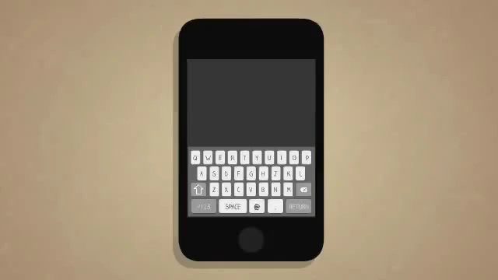

Slide 2
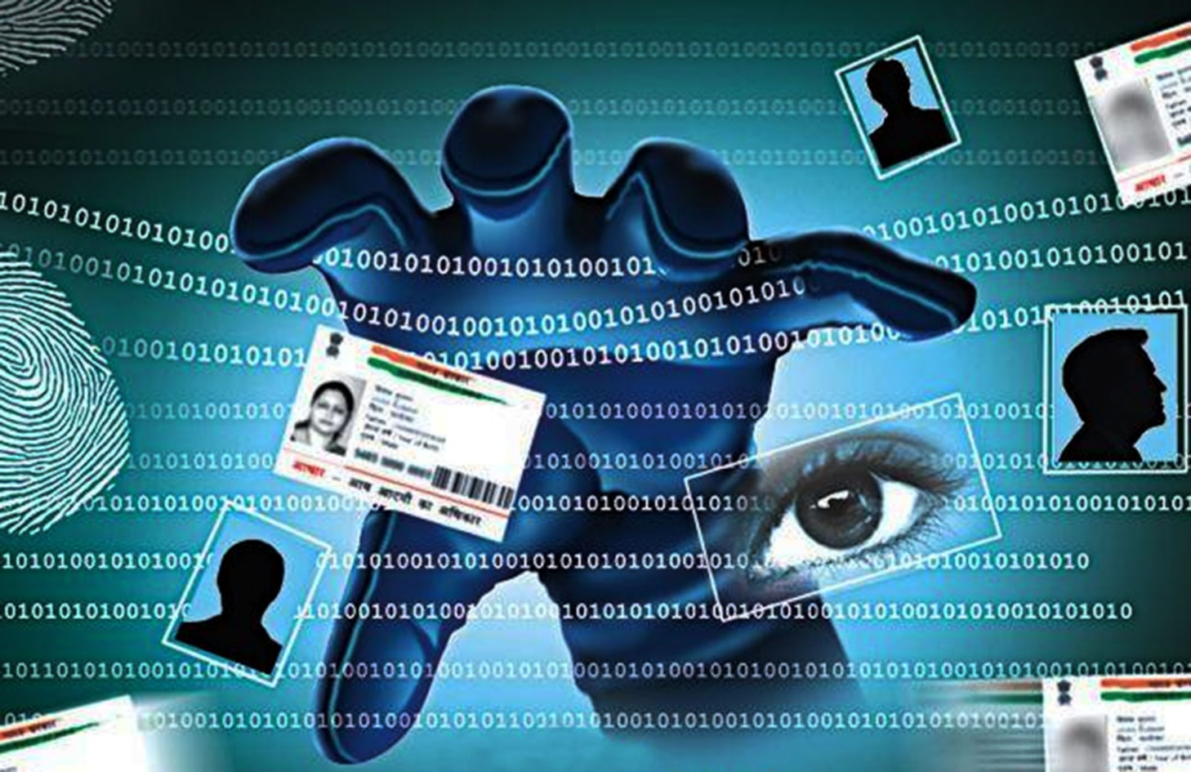
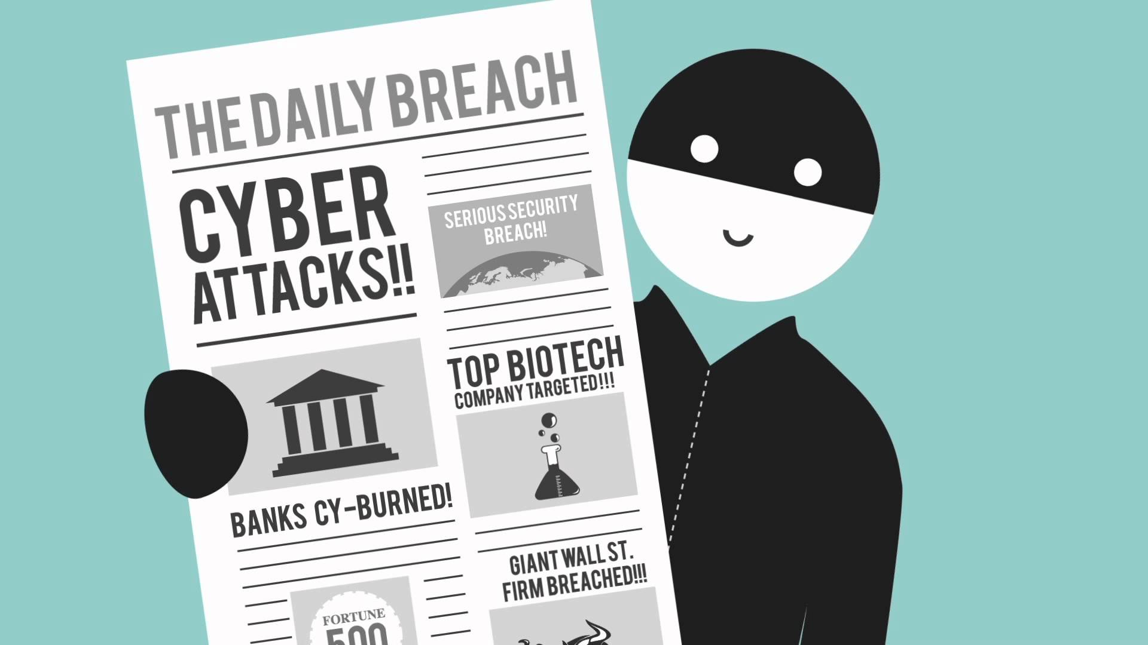
CYBER THREATS

Slide 3
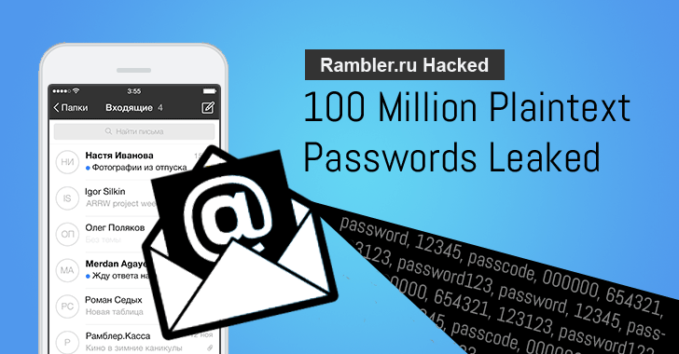
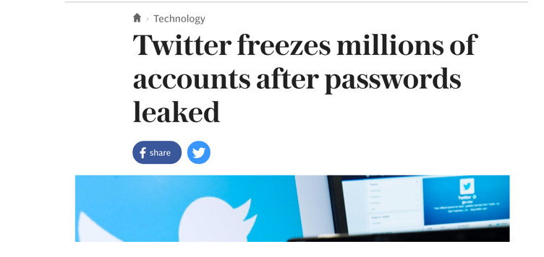
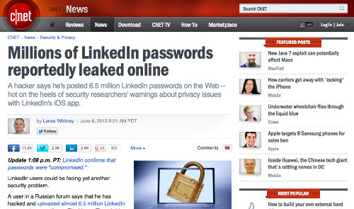
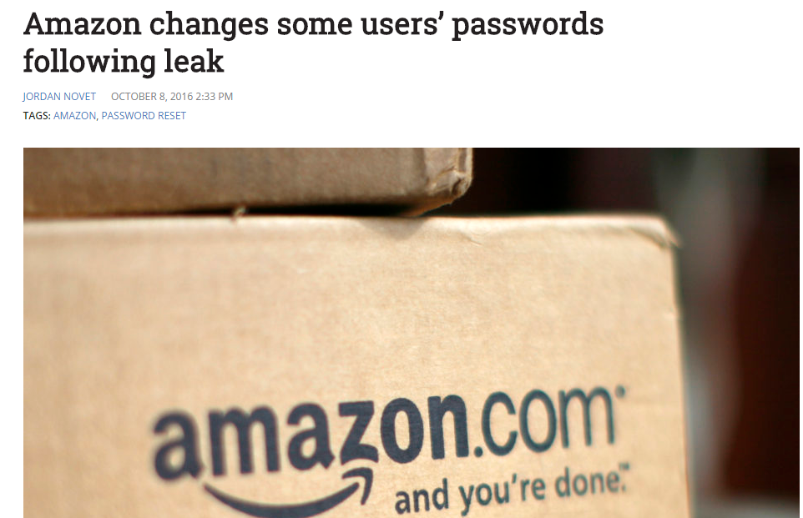


Slide 4

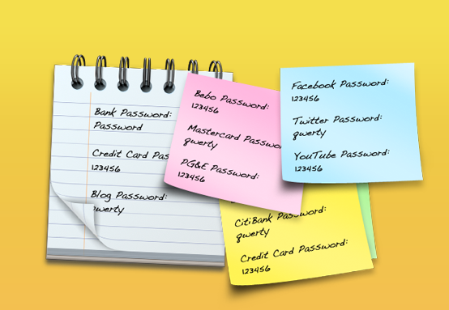
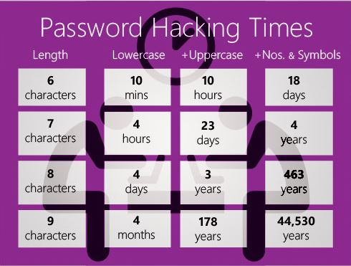
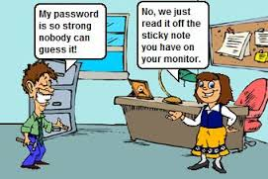
External Forces Accidental Action
Enable 2 step authentication wherever possible
Always use strong passwords
Revoke access to third party apps
Never write down passwords
Never have common passwords across sites
Never use common words as passwords
Never use personal details as passwords

Slide 5

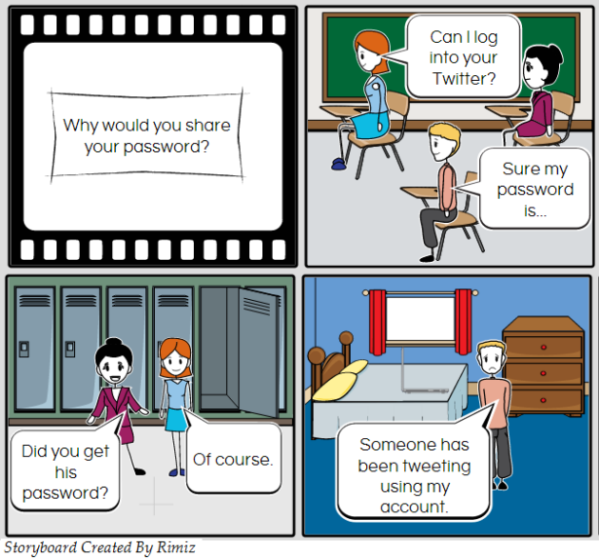
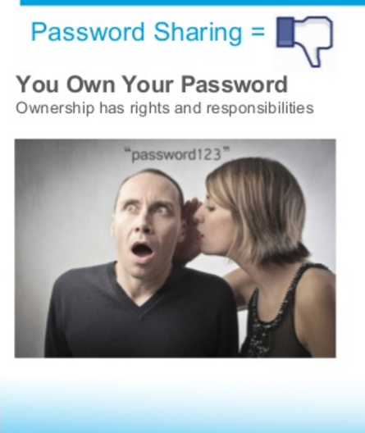

Password Sharing

Slide 6





CONSEQUENCES OF PASSWORD MISUSE
→leads to punishments
→Financial loss
→Personal data LOsS
→Personal reputation loss
→Leakage of country defense and security details

Slide 7
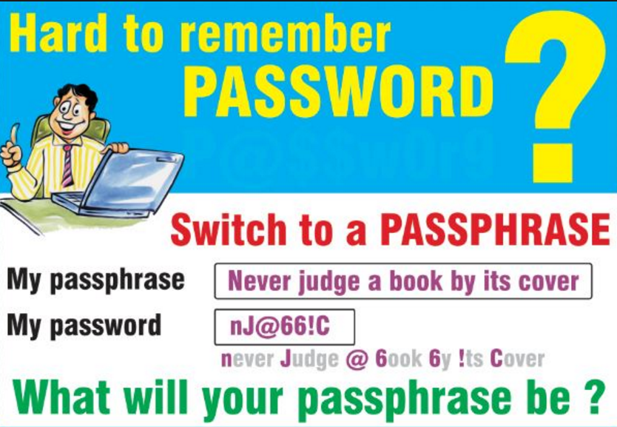

Slide 8
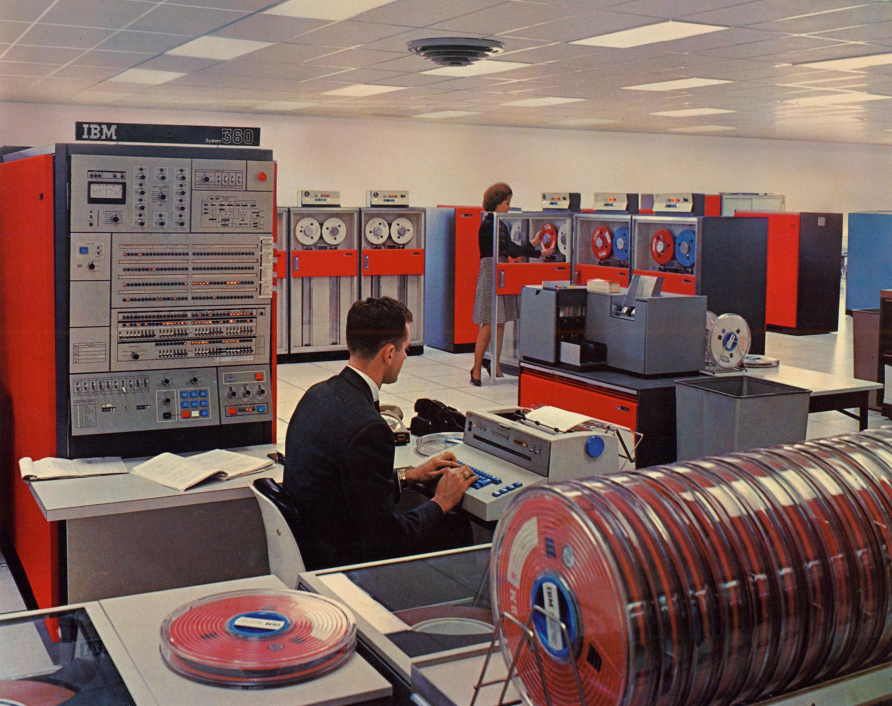
HACKING

Slide 9
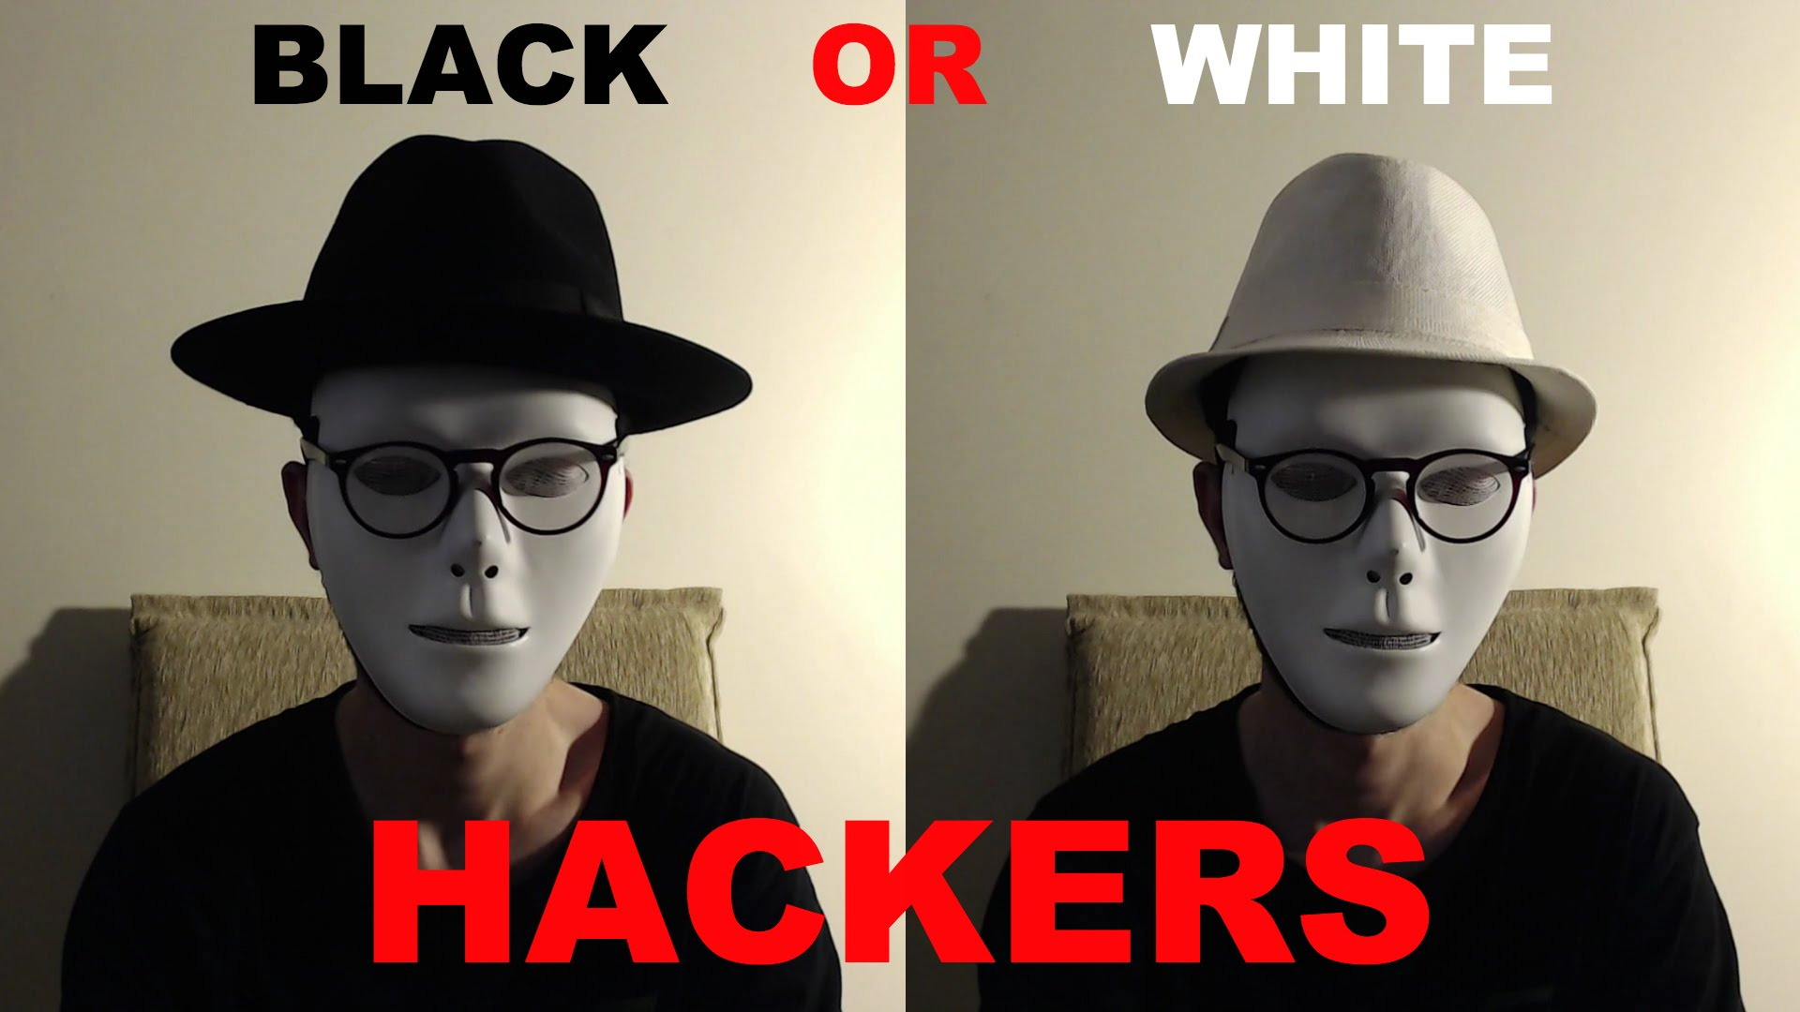


Slide 10
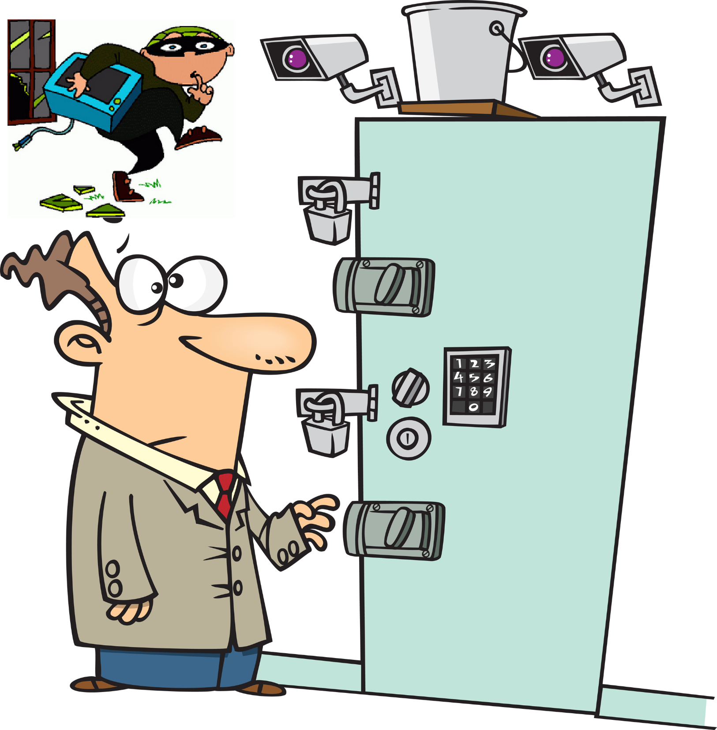

HOW EASY TO HACK MY COMPUTER

Slide 11
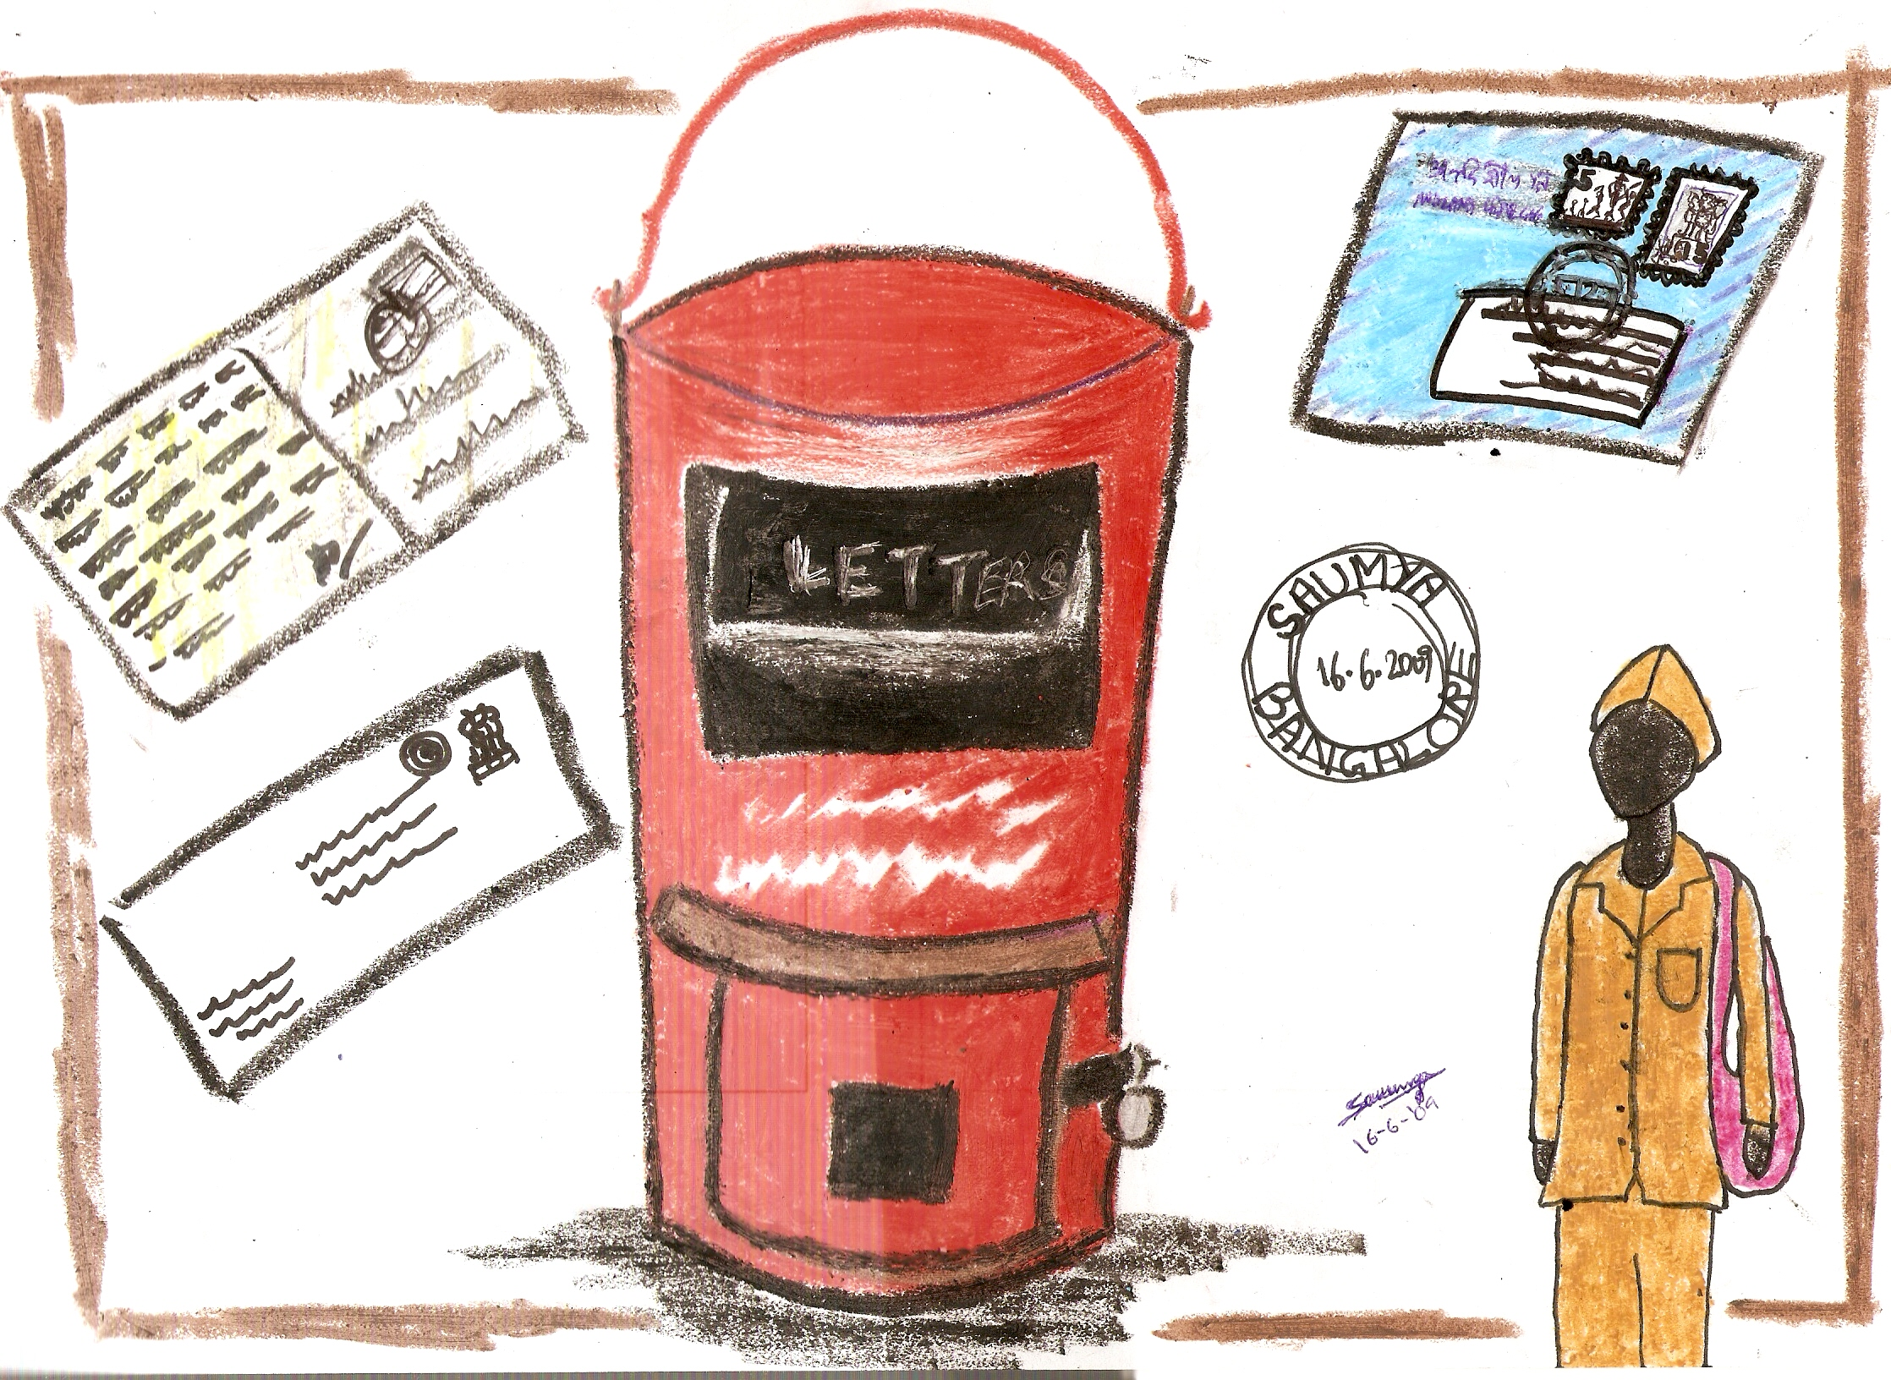
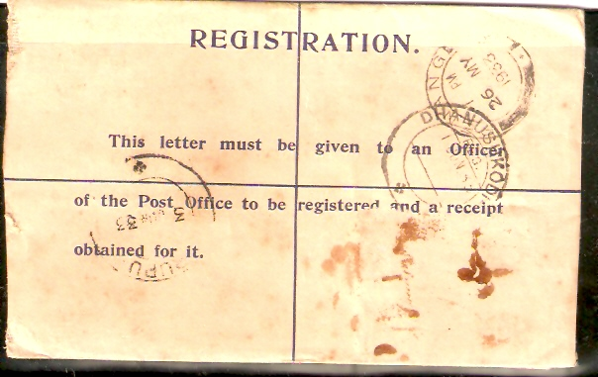
HOW TO TRACE HACKERS

Slide 12


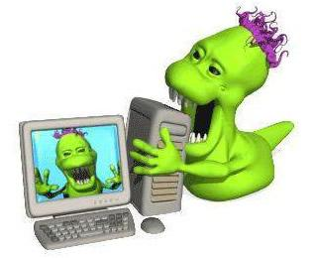

Slide 13
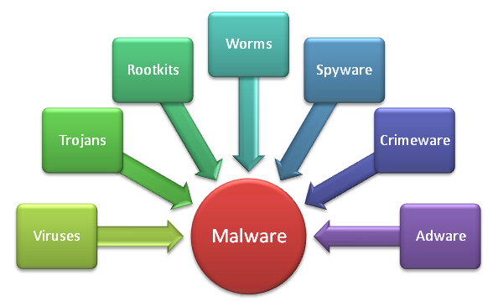

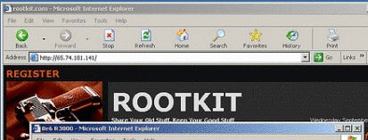







Slide 14

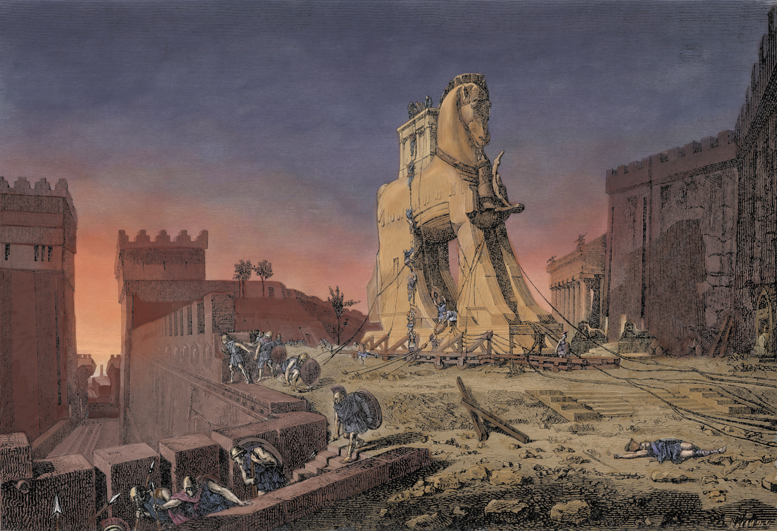
TROJAN HORSE

Slide 15




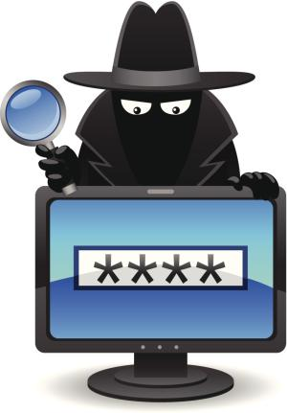

Slide 16

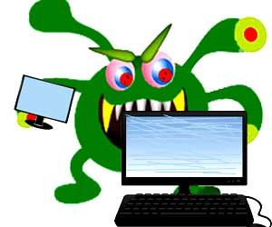

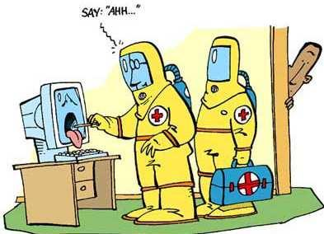

Slide 17
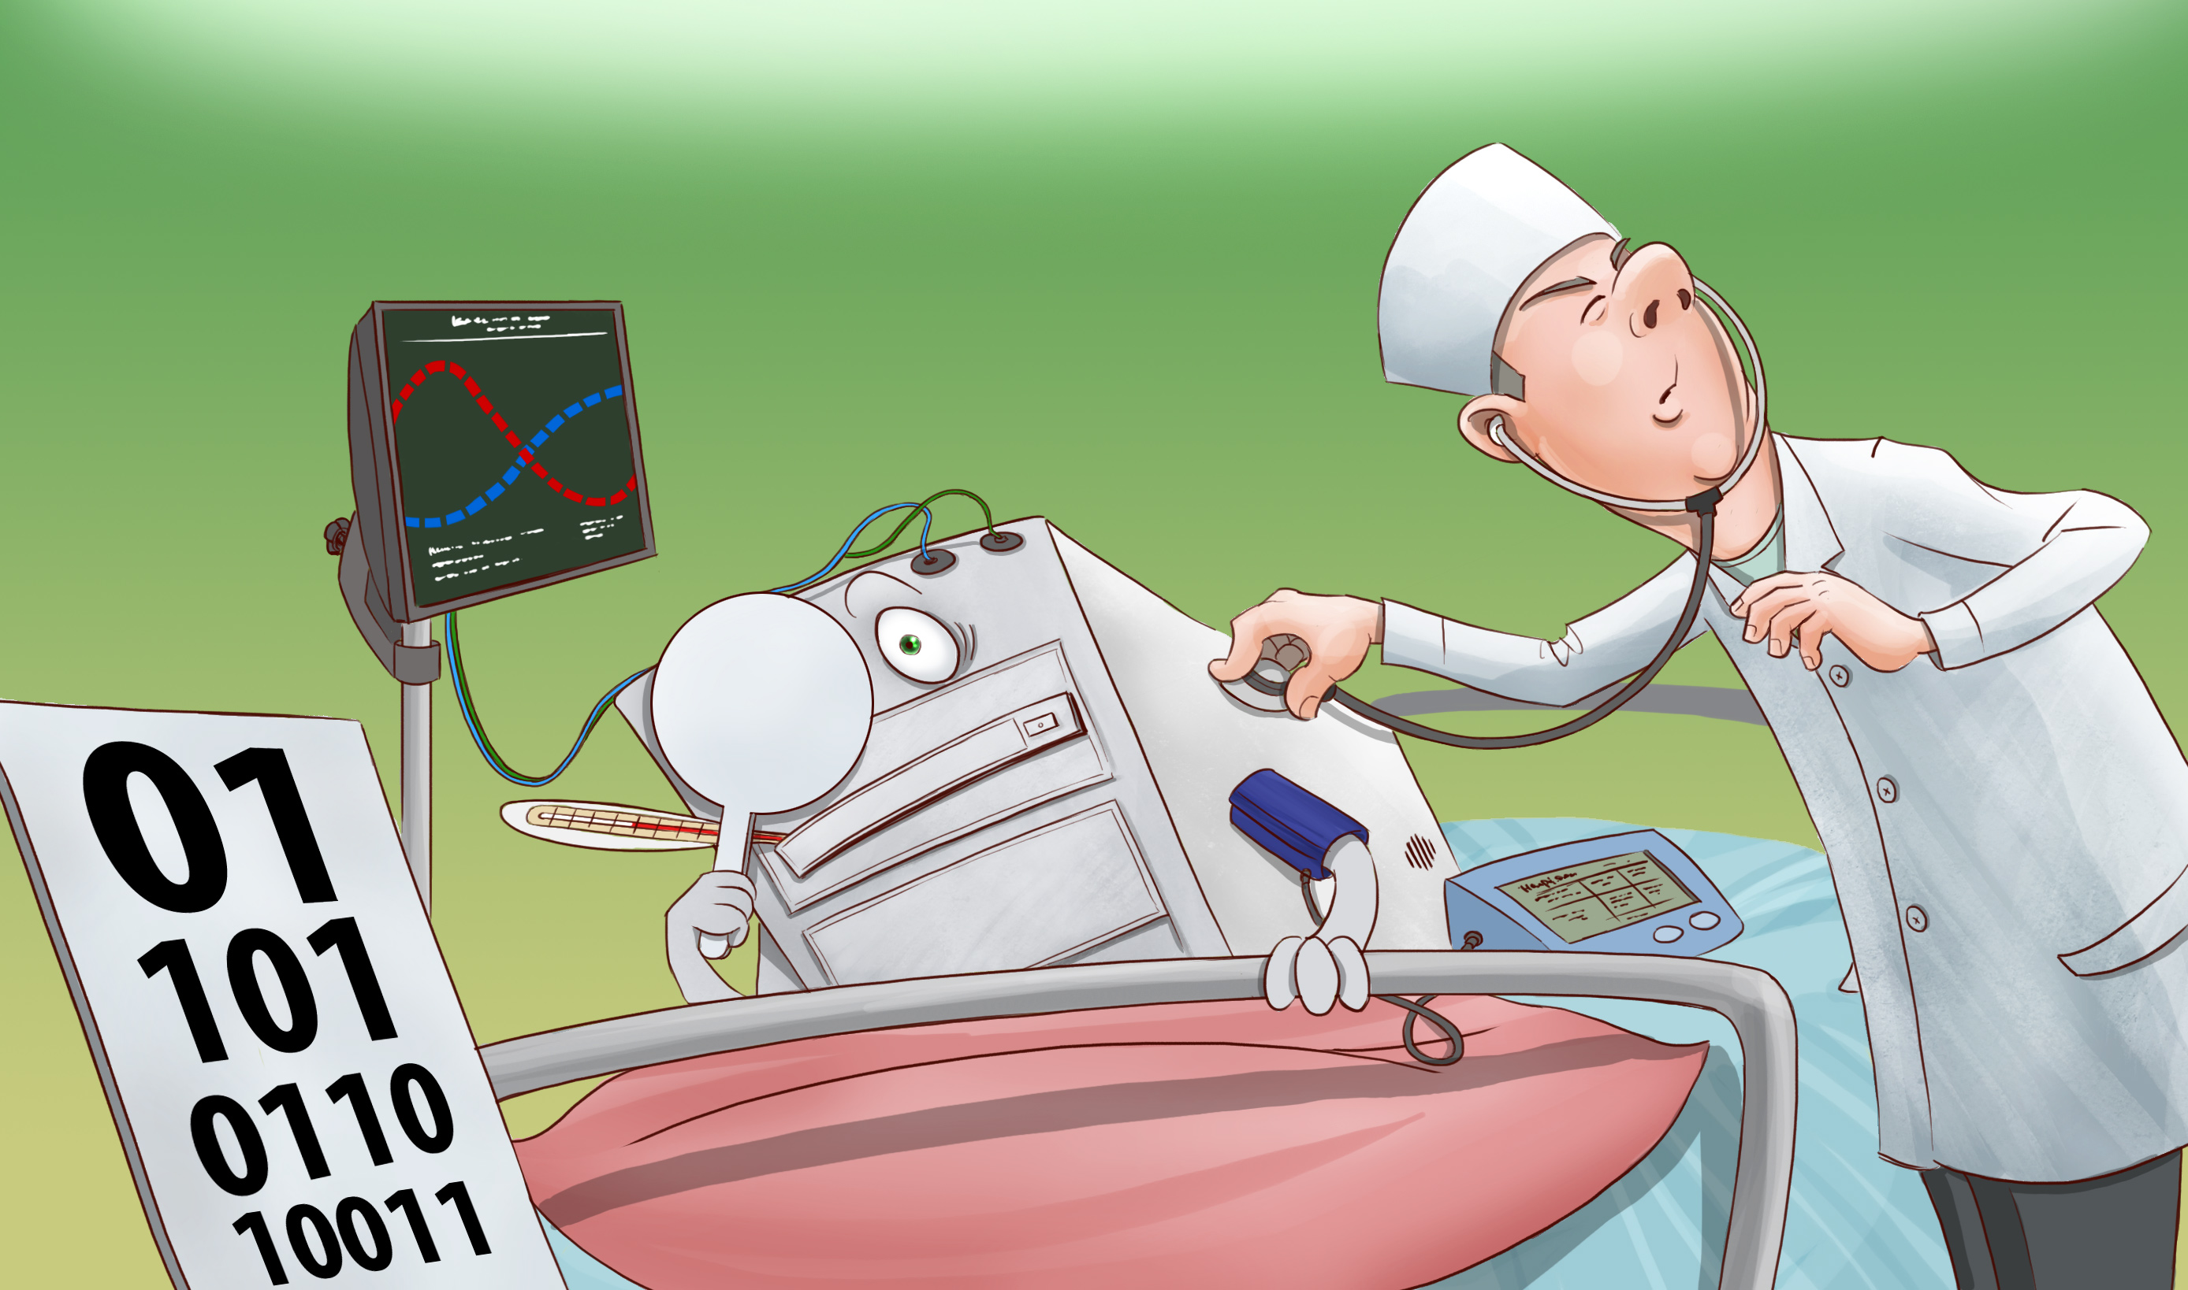
Malware symptom
Increased CPU usage
Slow computer or web browser speeds
Problem connecting to networks
Freezing or crashing
Modified or deleted files
Appearance of strange files, programs or desktop icons
Programs running, turning off or reconfiguring themselves
Strange computer behavior
Emails/messages being sent automatically

Slide 18

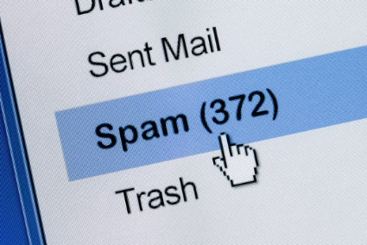
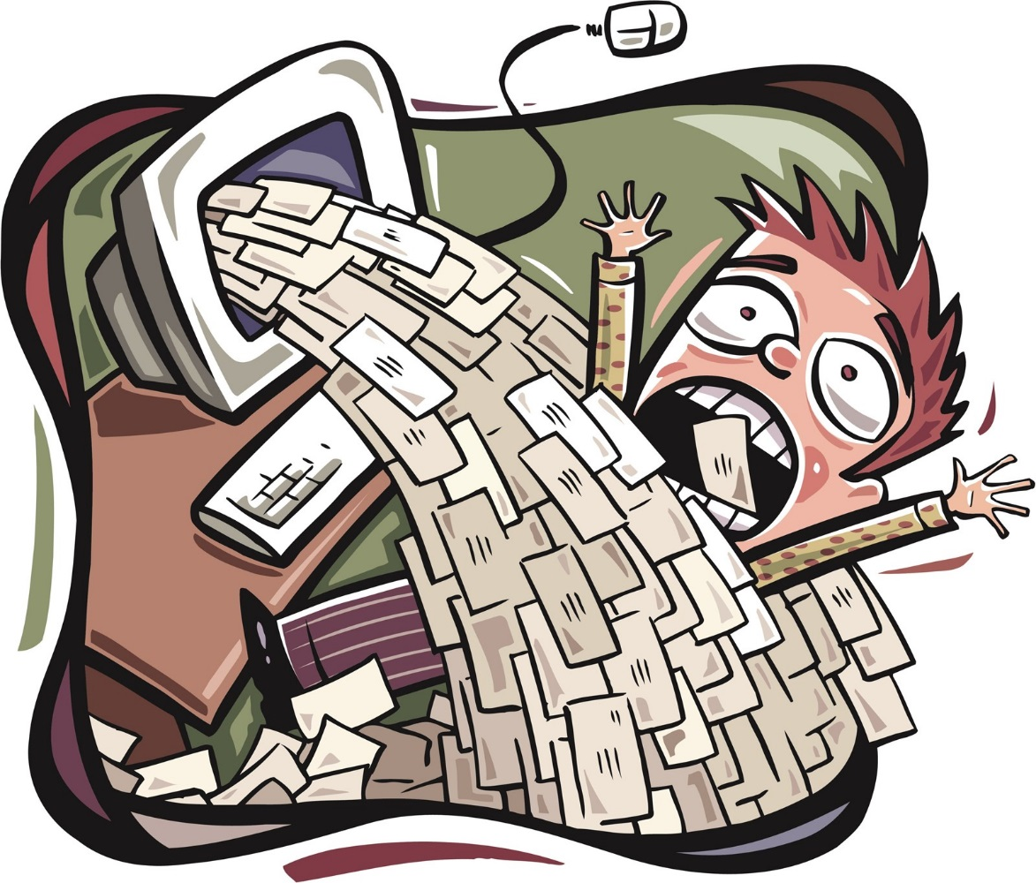



Slide 19
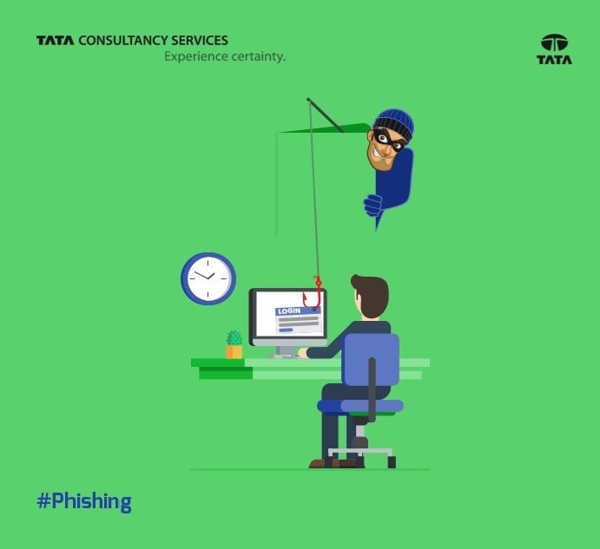

Slide 20
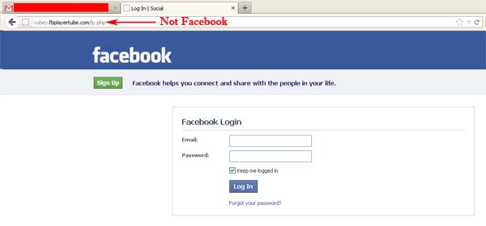
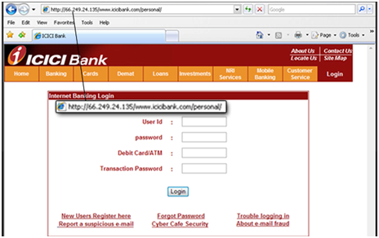
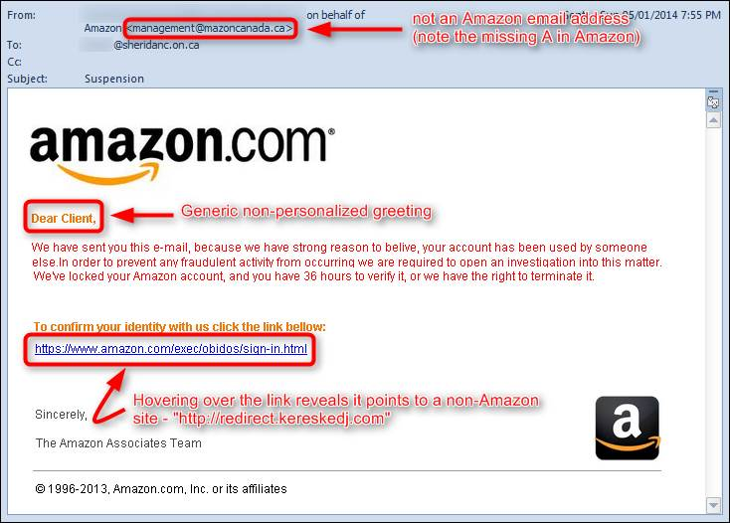
info.brienposey.com
brienposey.com.maliciousdomain.com

Slide 21
Phishing
The message contains a mismatched URL
URLs contain a misleading domain name
The message contains poor spelling and grammar
The message asks for personal information
The offer seems too good to be true
You didn’t initiate the action
You’re asked to send money to cover expenses
The message makes unrealistic threats
Learn to Identify Suspected Phishing Emails
Check the Source of Information From Incoming Mail
Never Go to Your Bank’s Website by Clicking on Links Included in Emails
Enhance the Security of Your Computer
Enter Your Sensitive Data in Secure Websites Only
Periodically Check Your Accounts and Change Password
Have the Slightest Doubt, Do Not Risk It
Enable Two Factor Authentication for your Bank Accounts, Emails, etc.

Slide 22
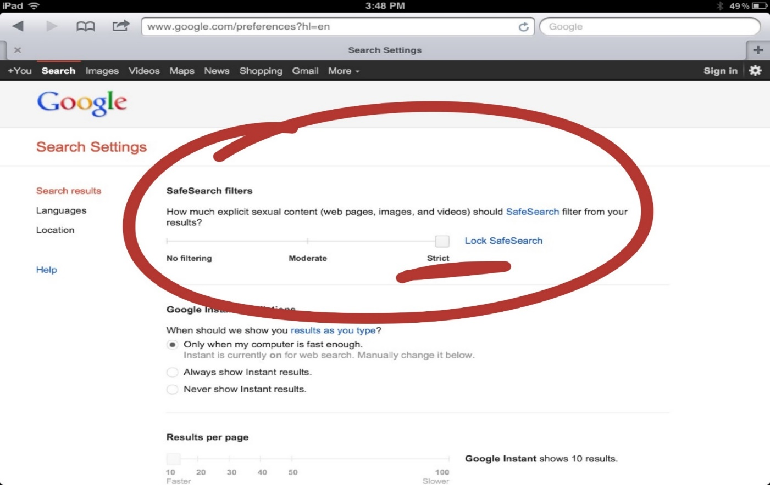
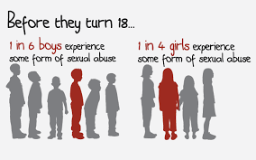
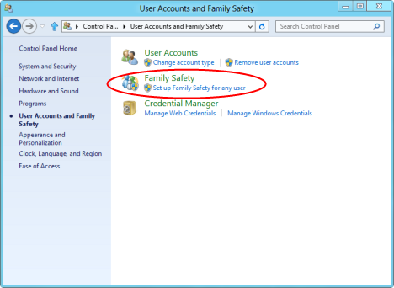
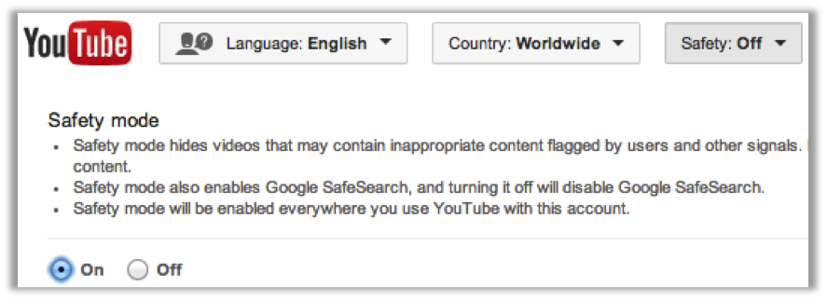
PORNOGRAPHY
Addiction and health issues
Child abuse
Lose respect for women
Increase woman and child abuse
Ruins career and leads to job loss
Causes shame and self-deprecation

Slide 23


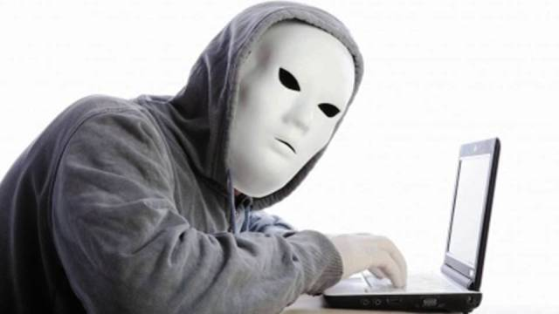
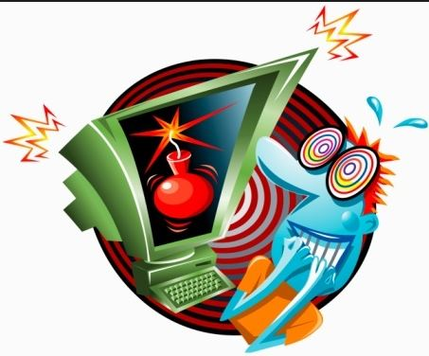
CYBER TERRORISM

Slide 24

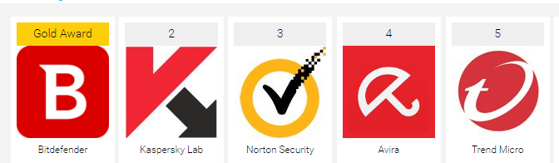
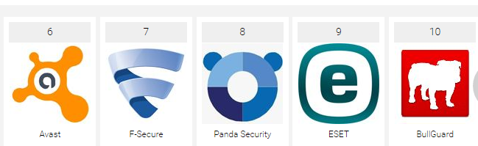
Anti Virus
Top Anti Virus
Scans specific files or directories for malware or known malicious patterns
Allows schedule scans
Free Anti Virus
Allows scan of a specific file or of computer, or of a CD or flash drive at any time
Remove any malicious code detected
Show you the ‘health’ of your computer

Slide 25

Never reveal personally identifiable information online
Never share your password with other people (except for your parents)
Never arrange meetings with strangers
Don’t believe everything you read or see online
Don’t download files or software without your parents’ permission
Don’t respond to inappropriate messages or emails
Don’t post inappropriate content
Don’t be bullied into fights
Don’t use adult sites
Understand what you put online will be there forever
Don’t click on links in unknown text
Download apps only from official app stores

Slide 26




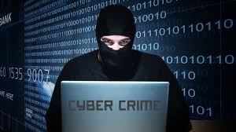
IT Act of India
India passed the Information Technology Act 2000 in May 2000 and notified it for effective on October 17, 2000
IT Act 2000 consists of 4 schedules 94 sections segregated into 13 chapters and focuses on providing legal recognition to e-commerce and on facilitating the filing of e-records with the government
Cyber Laws
ITA 2008 is the amendment of IT Act 2000, It has added new sections on offenses including Cyber Terrorism and Data Protection
Amendment has been passed by the Parliament on 23rd December 2008 and came into force from October 27,2009 onwards

Slide 27


Section | Offence | Punishment
Section 65 | Tampering with Computer System Document | Imprisonment up to three years, or fine which may extend up to two lakh rupees, or both
Section 66 | Hacking | Imprisonment up to 3 years or fine which extend up to 5 lakh rupees or both
 |  | If virus attack damages the computer or computer network A compensation of 5 crore
Section 66 B | Receiving Stolen Computer or Communication Device | Imprisonment up to 3 years or fine which extend up to 1 lakh rupees or both
Section 66 C | Identity Theft | Imprisonment up to 3 years or fine which extend up to 1 lakh rupees or both
Section 66 D | Cheating by personation by using computer resources | Imprisonment up to 3 years or fine which extend up to 1 lakh rupees or both
Section 66 E | Violation of Privacy | Imprisonment up to 5 years and fine of 10 lakh rupees
Section 66 F | Cyber Terrorism | Imprisonment which may extend to life
Section 67 A | Pornography | Imprisonment up to 5 years and fine of lakh
Section 67 B | Child Pornography | Imprisonment up to 5 years and fine of lakh
Section 70 | Un-authorized access to protected system | Imprisonment which may extend to ten years and shall also be liable to fine
Section 74 | Publication for fraudulent purpose | Imprisonment up to two years, or with fine which extend to 1 lakh rupees, or with both

